Slide 1
Reducing HEC-RAS Runs
Haden Smith
Lead Engineer – USACE-RMC
William Lehman
Senior Economist – USACE-HEC
Keil Neff
Senior Hydraulic Engineer – USACE-RMC

Slide 2
Problem Statement
Objective: Estimate marginal (pointwise) AEP-Depth grids within a HUC 4 basin using HEC-RAS 2D.
Approach: Derive excess rainfall forcings for HEC-RAS from routing SST with HEC-HMS.
Challenge: Running the full set of SST storm simulations in HEC-RAS with full uncertainty (aka “The Full Monty”) is cost prohibitive.

Slide 3
Potential Solution
Reduce cloud compute costs by at least 50%.
Reduce the number of uncertainty realizations to 500, which will provide sufficiently accurate 90% confidence intervals.
Reduce the number of RAS runs by sub-sampling storm events from the SST-HMS outputs.
Notes:
We could also replace RAS with a surrogate model.

Slide 4
Sub-Sampling Options
Objective: Develop a sub-sampling method that does not disrupt the current modelling chain.
Rejection sampling heuristic
Nonparametric sub-sampling with k-Nearest Neighbors
Sub-sampling with a Gaussian Copula
Marginals are nonparametric
Joint distribution is a Gaussian Copula
Hybrid approach
Modelling chain remains the same for all strategies
SST
HEC-HMS
HEC-RAS

Slide 5
Rejection Sampling Heuristic
One Possible Rejection Strategy:
Estimate the 72-hr basin-average (BA) depth for each storm in the SST simulation.
Rank the BA depths and assign plotting positions.
Only run storms in HEC-RAS where the BA depth is greater than the 5-year (0.2 AEP).
i.e., reject the small storms, and only run the largest 20% of storms in HEC-RAS.
This reduces the number of HEC-RAS runs by 80% (N x 0.2).
Note: Th team already successfully tested a rejection strategy option on Kanawha Basin. More study needs to be done to select an optimal rejection criteria.

Slide 6
Nonparametric Sub-Sampling with k-Nearest Neighbors
Define importance criteria, such as peak flow.
Define the Reduced-Order Model or Surrogate Model for HEC-RAS:
We will use HEC-HMS as the ROM.
Define target locations within the ROM to output the importance criteria.
The target locations can be weighted based on additional criteria.
Run SST with the ROM and post-process:
Develop empirical marginals and joint distribution for the targets.
This defines the importance grid.
Use k-NN to sub-sample from the importance grid.
This can reduce the number of RAS runs by a factor of 100 to 1,000 (N x 0.01 or N x 0.001).

Slide 7
Sub-sampling with a Gaussian Copula
Define importance criteria, such as peak flow.
Define HEC-HMS as the ROM.
Define target locations within the ROM to output the importance criteria.
Run SST with the ROM and post-process:
Develop empirical marginal distributions for the targets.
Develop joint distribution with Gaussian copula.
This defines the importance grid.
Use Gaussian copula to sub-sample from the importance grid.
This could reduce the number of RAS runs up to a factor of 100 (N x 0.01).

Slide 8
Proof-of-Concept: Methodology
Select Importance Sampling Criteria
Select Reduced-Order Model Targets
Perform k-NN Sub-Sampling
Post-Process

Slide 9
Define Importance Sampling Criteria
Define the importance criteria: Identify characteristics that define a storm’s importance:
Precipitation metrics: total rainfall, peak intensity, storm duration, or spatial distribution.
Hydrologic response metrics: peak flow, peak stage, or flow duration.
Consequence response metrics: property damage ($) or life loss.
For this proof-of-concept, we use peak flow.

Slide 10
Reduced-Order Model
Use a lumped HEC-HMS model to generate the importance sampling grid for HEC-RAS 2D.
Ensure compatibility with both low-fidelity (ungaged) and high-fidelity (gaged) HMS models, with a preference for high-fidelity models when available.
Utilize Muskingum-Cunge routing for all HMS reaches where possible.
Identify critical basin locations to record peak flows as target points.
Optional: Prioritize target locations with the highest population at risk or largest contributing drainage areas, assigning them greater weight.
Optional: Add stage-discharge rating curves to all target locations in HMS to capture peak stages. Additionally, transform discharge-to-stage-to-damage at each target.

Slide 11
Reduced-Order Model
Strong hydrologic correlation is desirable!
Conceptual Basin Schematic
Upstream targets have hydrologic influence on downstream targets.
Even if the spatial rainfall correlation of the storms is relatively weak, there will be some amount of positive hydrologic correlation in the targets due to the influence of the node network.
T1
T3
T4
T2
T5

Slide 12
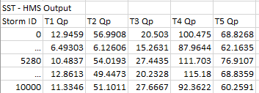
k-NN Sub-Sampling Routine
Sample ~100,000 SST events, where there is an average of 10 events per year, for 10,000 years.
Route storm events in HEC-HMS model and record peak flows at each target location.

Slide 13
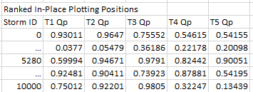
k-NN Sub-Sampling Routine
For each target location, rank the peak flows in-place and assign it a plotting position, i.e., do NOT sort the data.
This creates the nonparametric joint distribution to sample from.

Slide 14
k-NN Sub-Sampling Routine
Standardize the plotting positions using the inverse CDF of the Standard Normal distribution.
k-NN relies on a distance measure. Distance is sensitive to scale, so normalizing/standardizing the features is critical to achieve good results.
Perform sub-sampling using k-Nearest Neighbors:
Stratify probabilities into m-bins. The desired probability is applied to all targets – i.e., perfect statistical correlation is desired; however, this can never be achieved. We can relax this assumption by increasing k.
Sample the k-Nearest Neighbors that most closely match the stratified probability vector.
Post-Process frequency curves using the Total Probability Theorem

Slide 15
Proof-of-Concept: Case Study
25,040 SST events were routed with HEC-HMS, where there was an average of 10 events per year, for 2,000 years.
The proposed K-NN sub-sampling routine was used to reduce 25,040 storm event down to 1,000 sub-samples.
Partial duration frequency curves are plotted for demonstration.

Slide 16
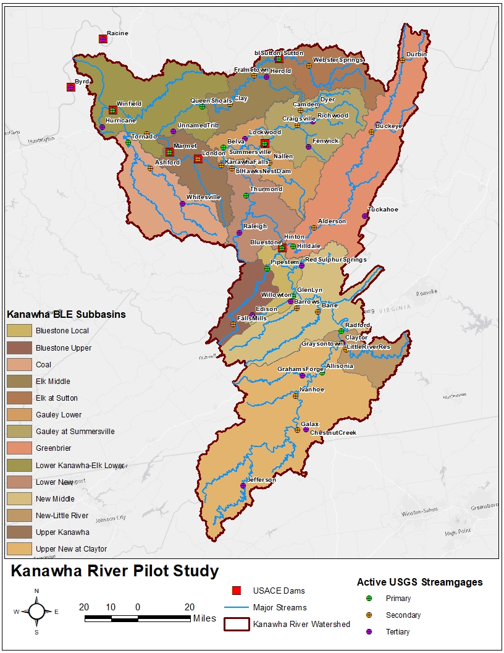
Kanawha Basin
Target Short Name | Type
Allisonia | Primary
Belva | Primary
Bluestone | Primary
GlenLyn | Primary
Hilldale | Primary
Marmet | Primary
Pipestem | Primary
Queen Shoals | Primary
Radford | Primary
Summersville | Primary
Sutton | Primary
Thurmond | Primary
Tornado | Primary
Winfield | Primary

Slide 17
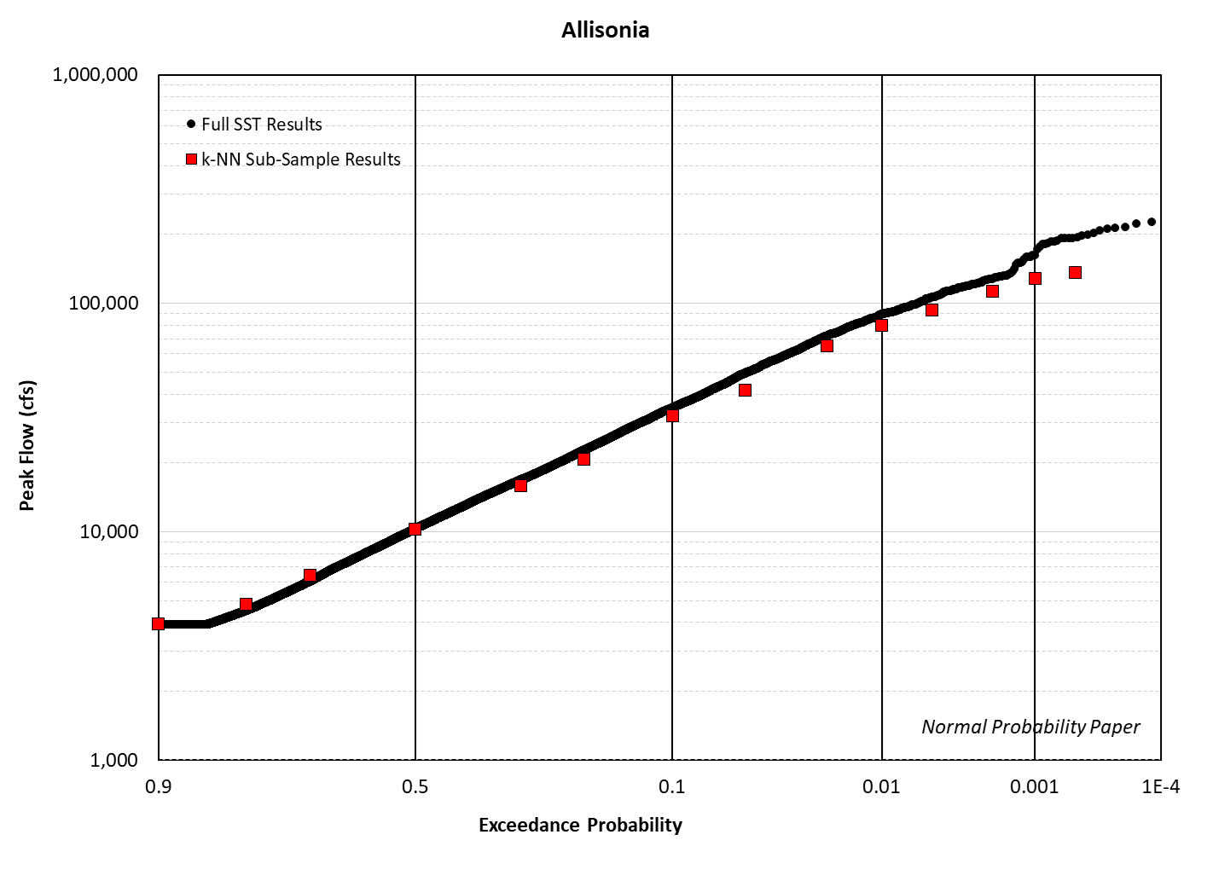
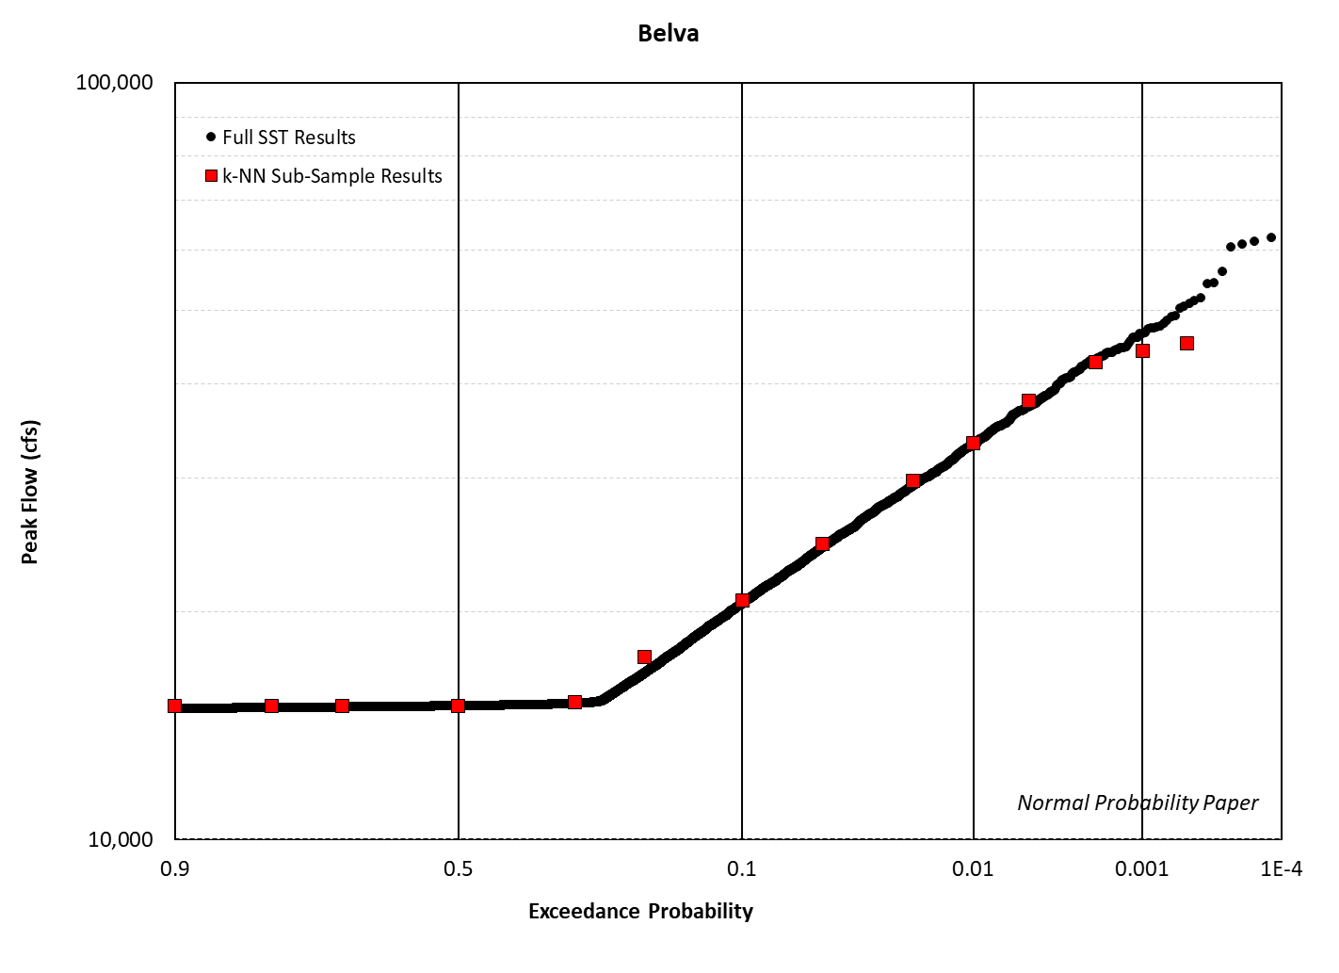
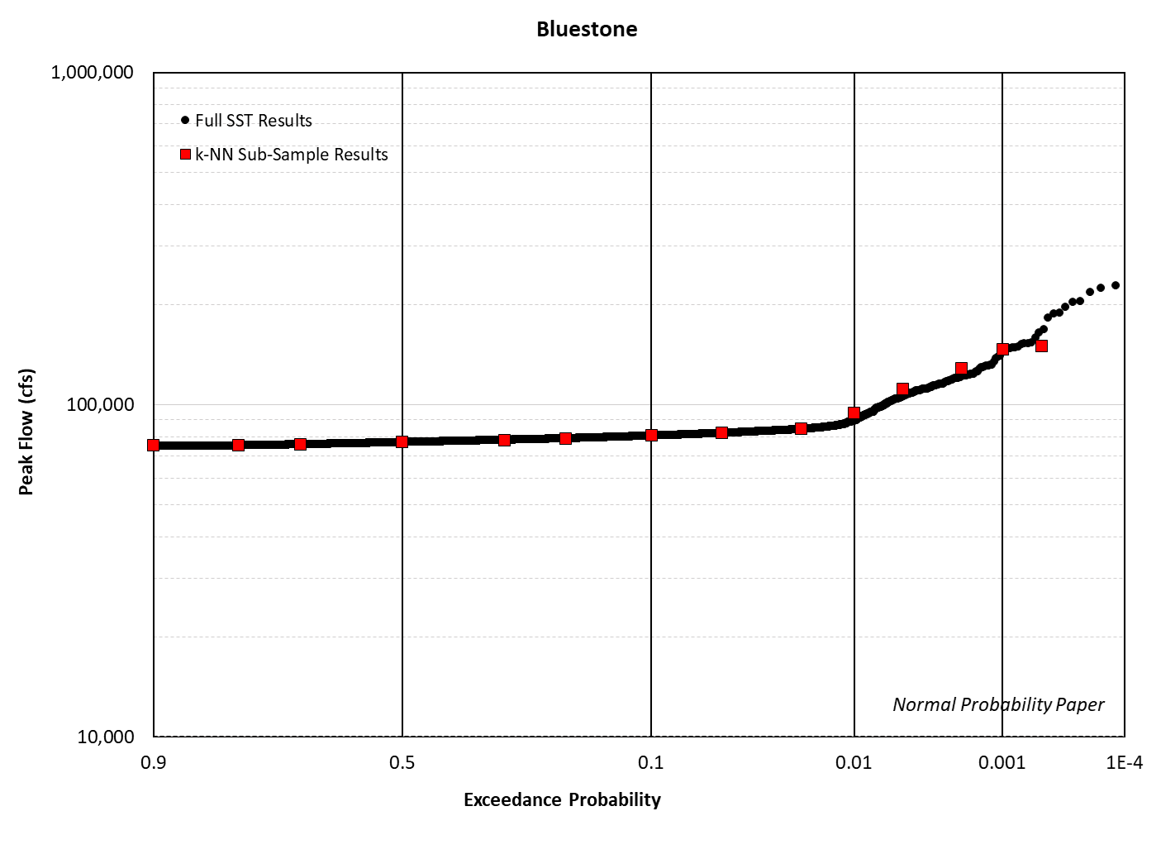
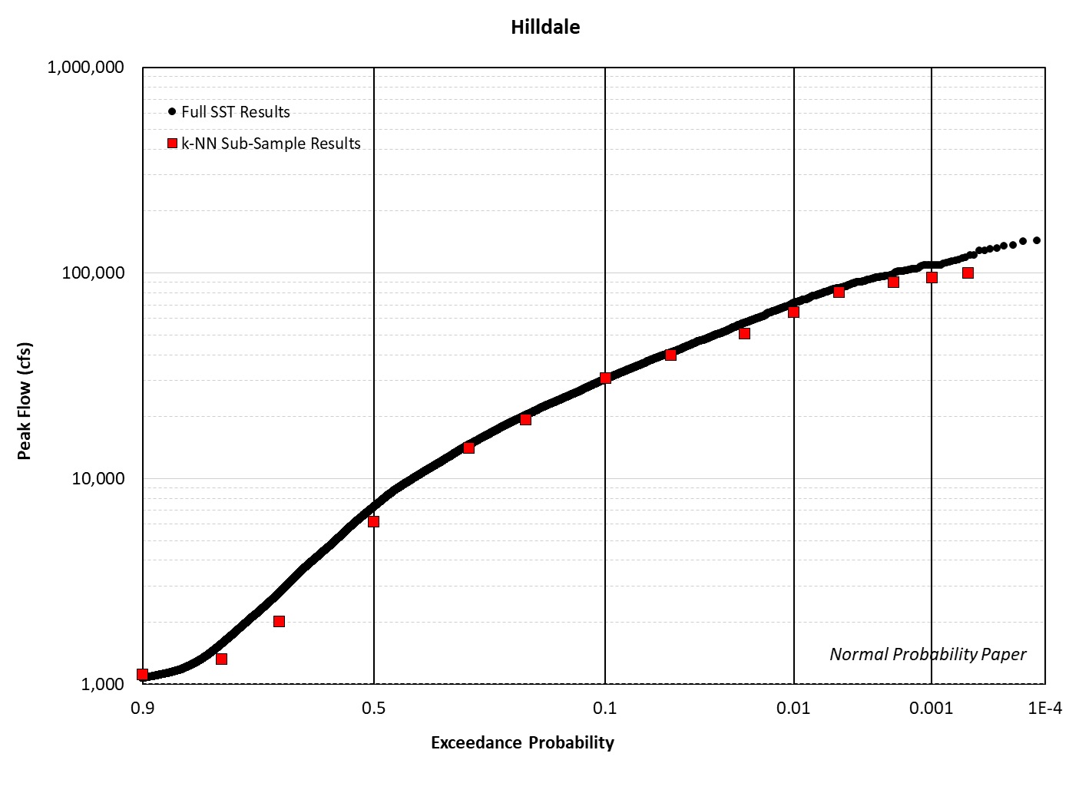
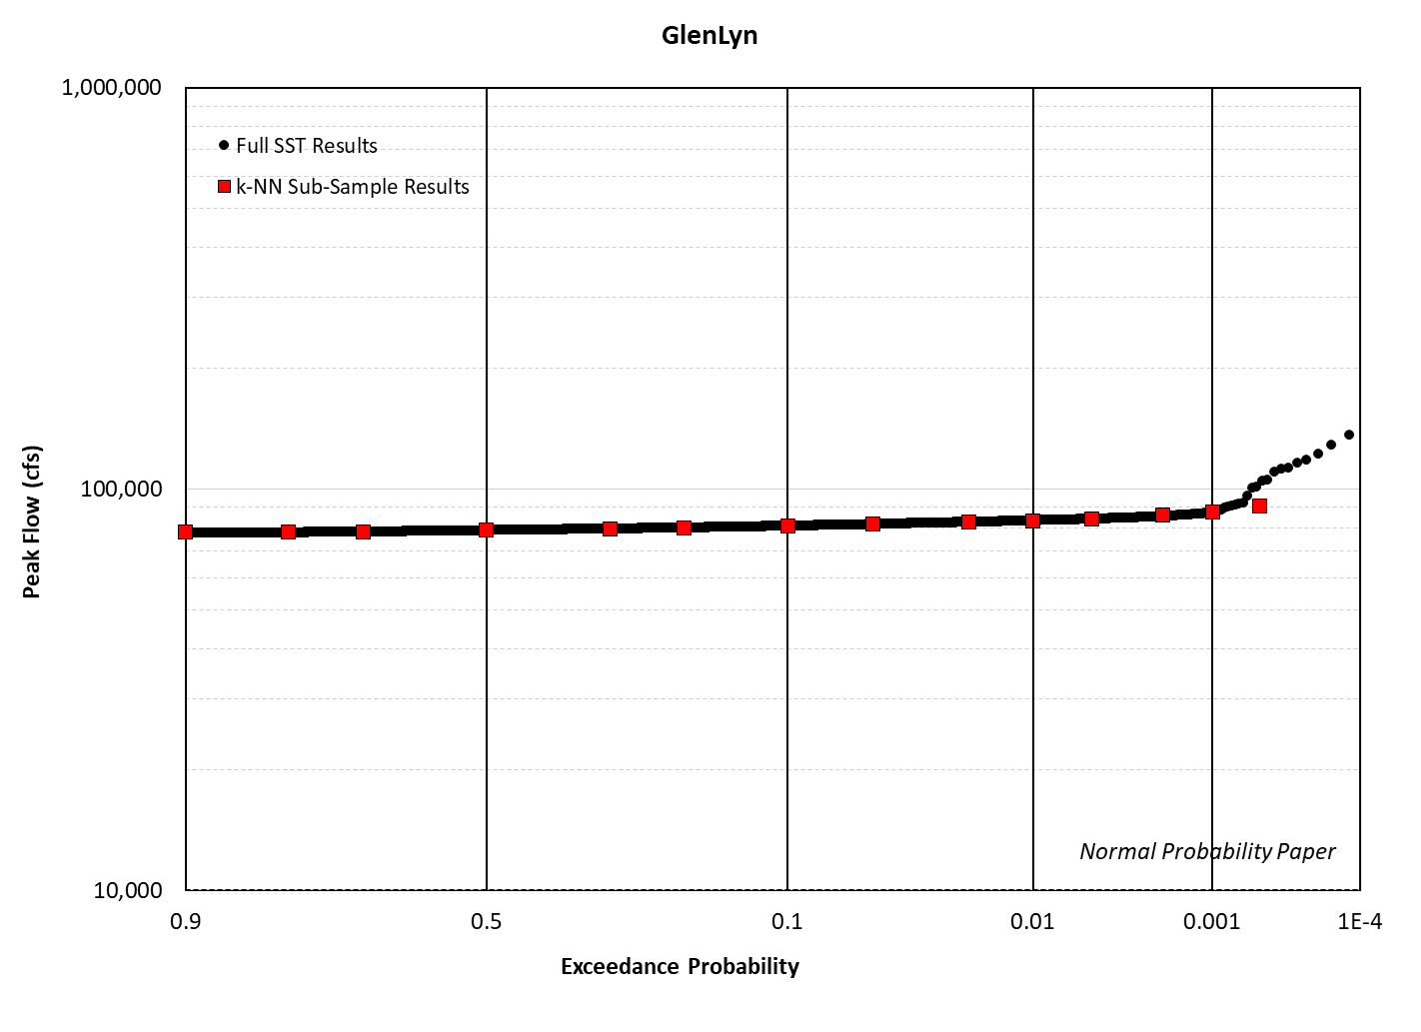
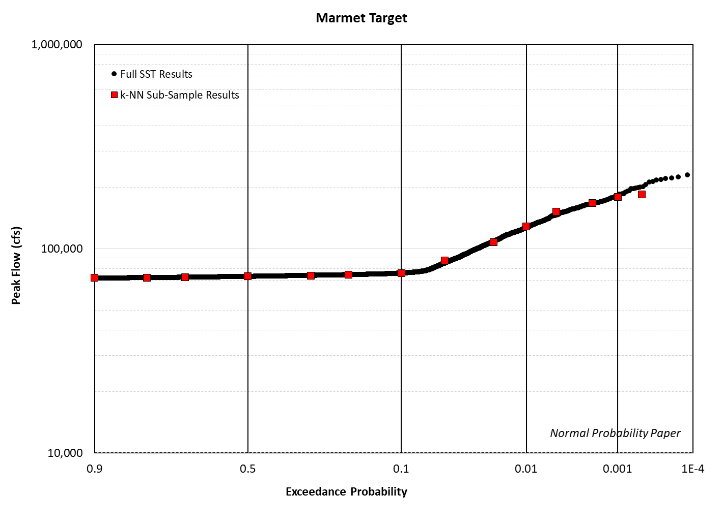
Kanawha Basin

Slide 18
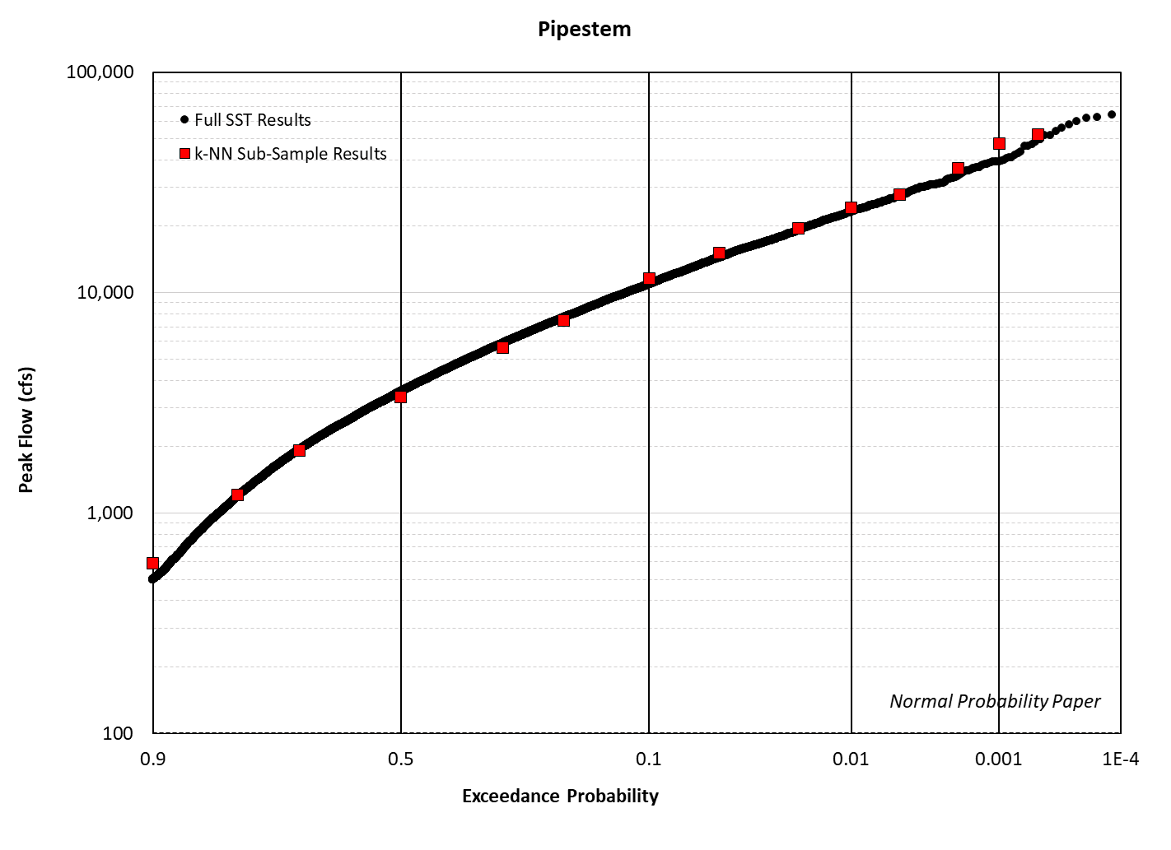
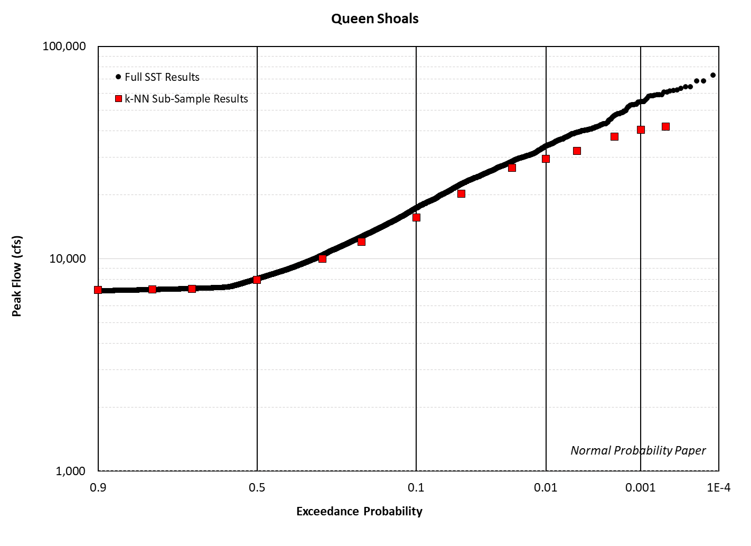
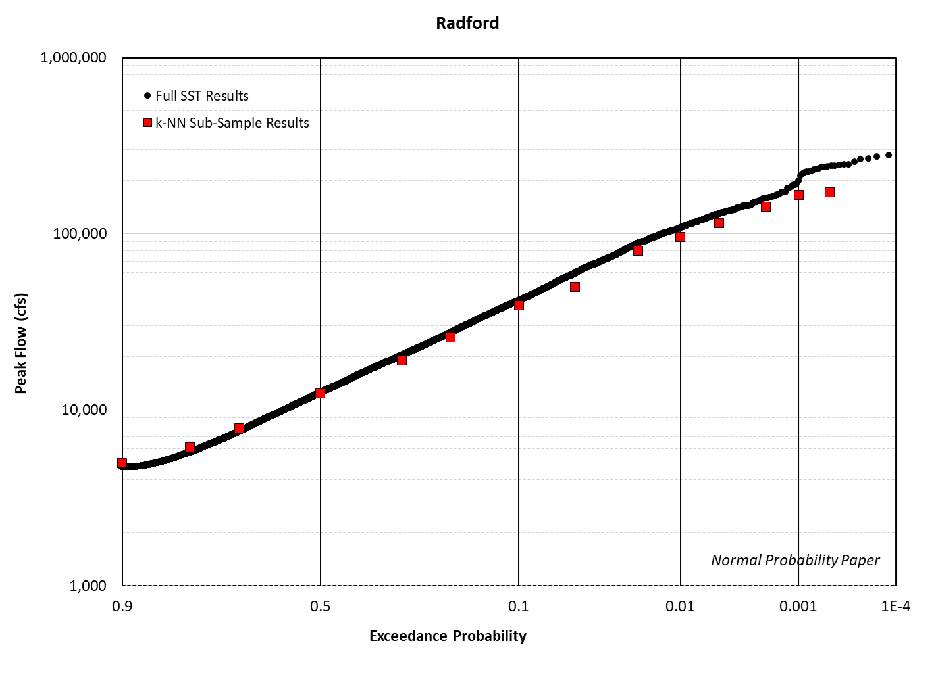
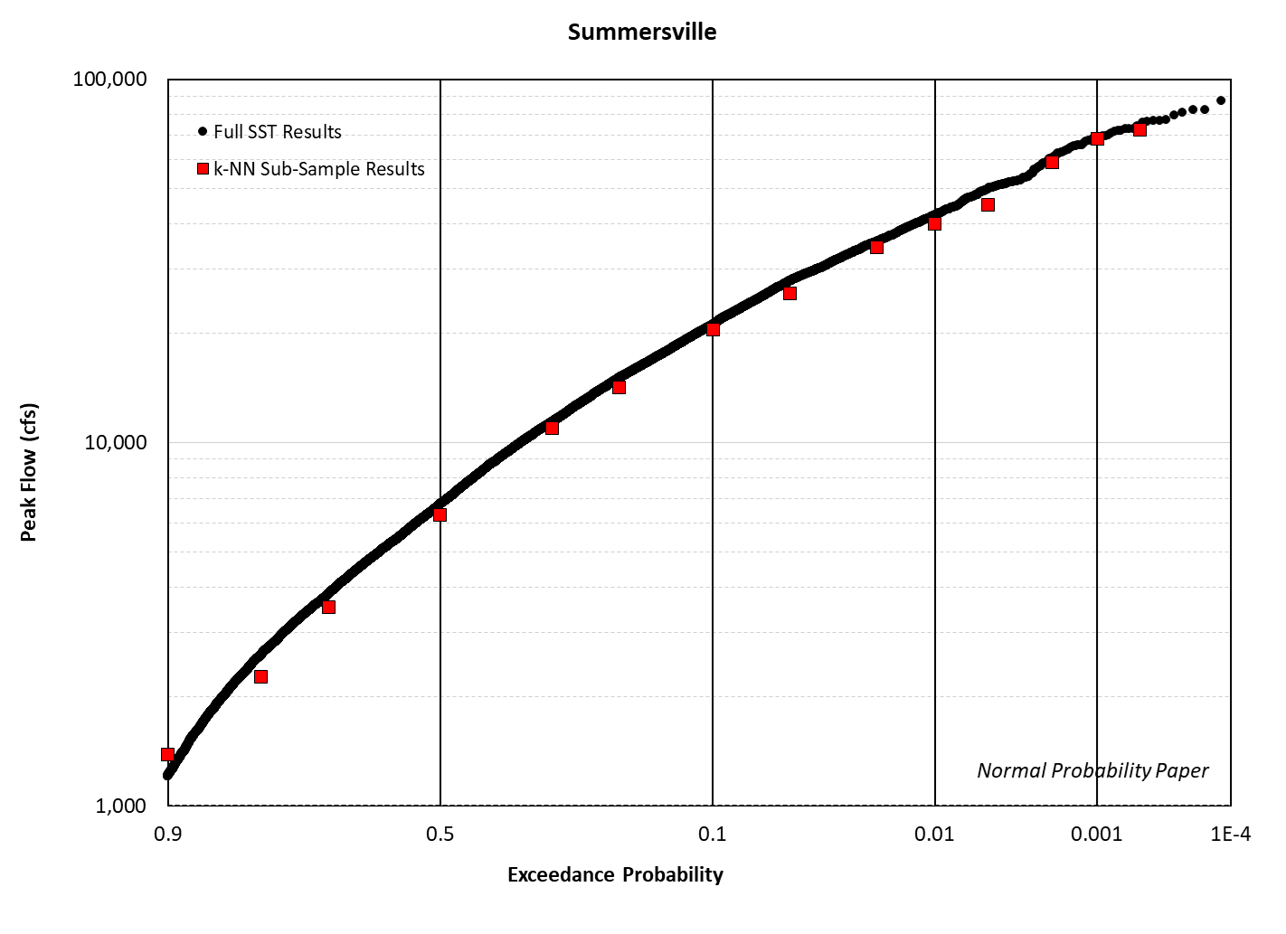
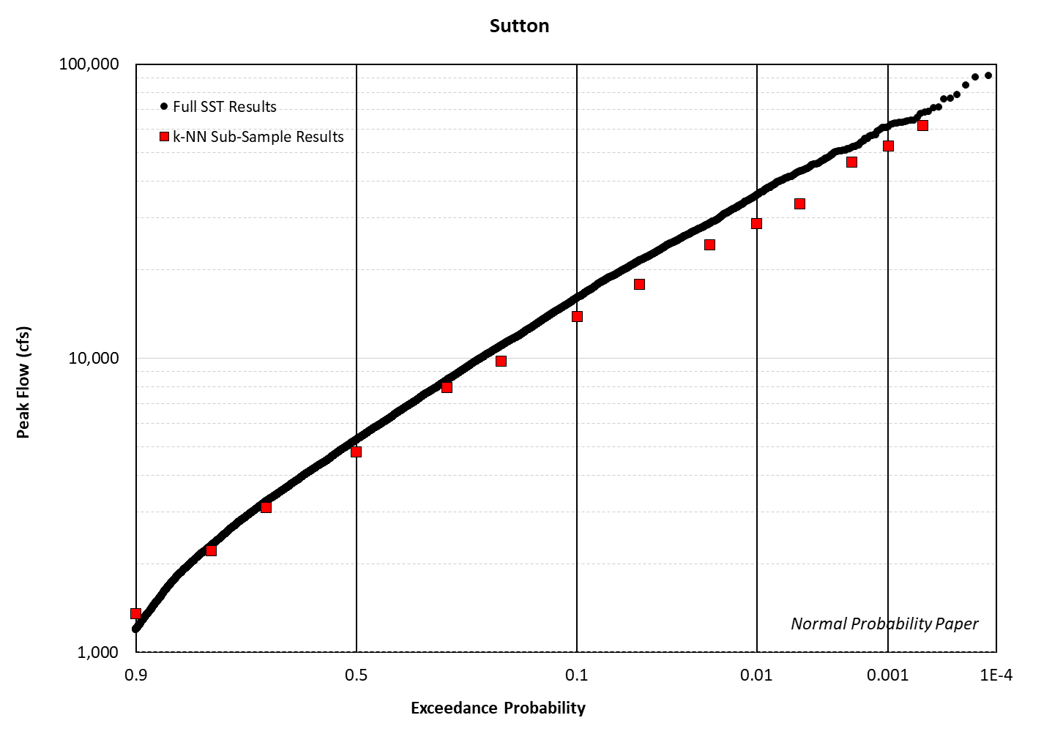
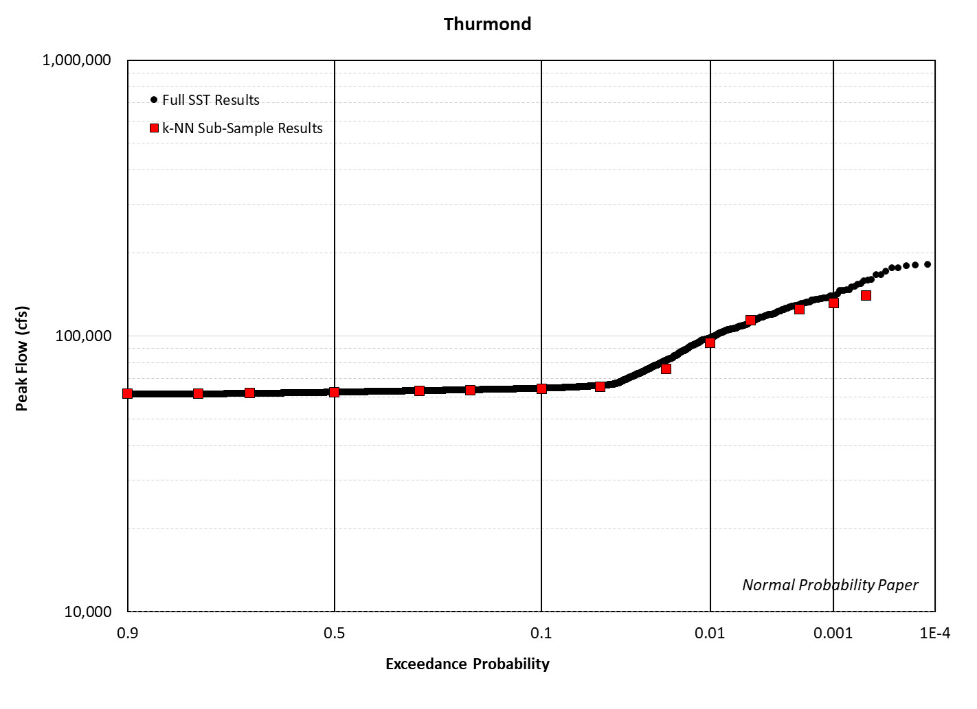
Kanawha Basin

Slide 19
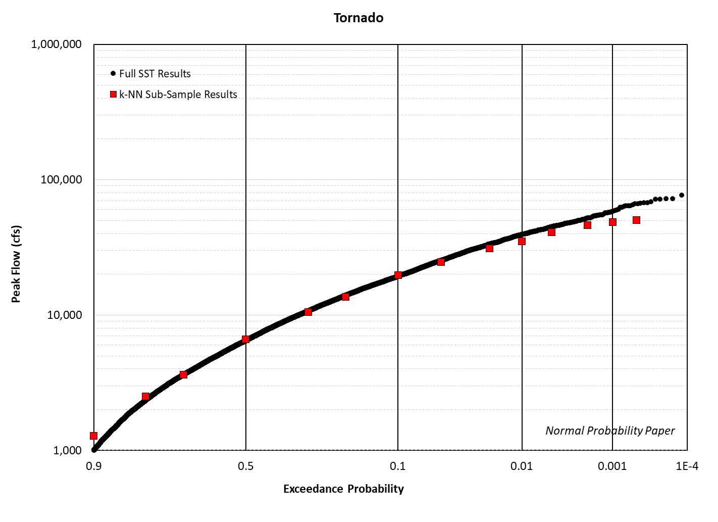
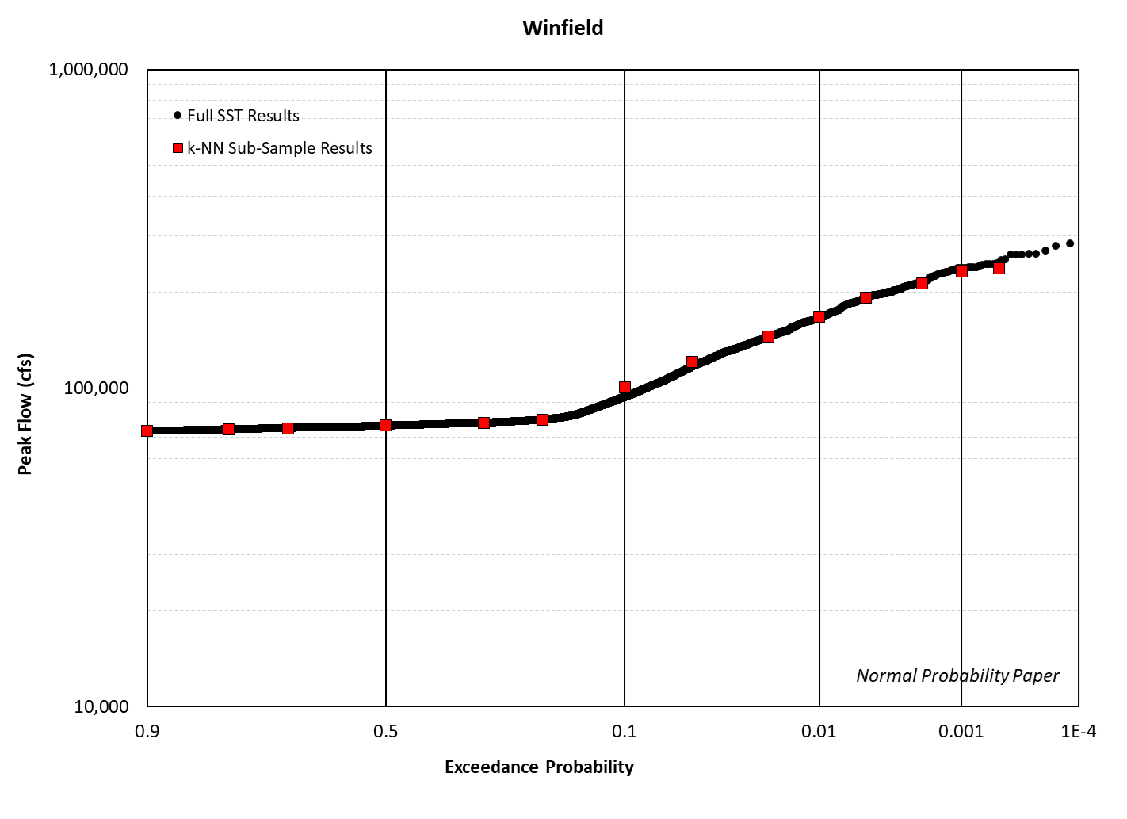
Kanawha Basin
Target Short Name | Quantile R-Squared
Allisonia | 0.98
Belva | 0.99
Bluestone | 0.97
GlenLyn | 0.83
Hilldale | 0.99
Marmet | 0.99
Pipestem | 0.99
Queen Shoals | 0.98
Radford | 0.98
Summersville | 1.00
Sutton | 0.99
Thurmond | 0.99
Tornado | 0.99
Winfield | 1.00
Sub-Sample (N=1,000) has near perfect agreement with population sample (N=25,040) for most quantiles.
Performance degrades at rare AEPs (0.01 or smaller)
A larger SST-HMS population size (N=100,000) will likely improve performance.

Slide 20
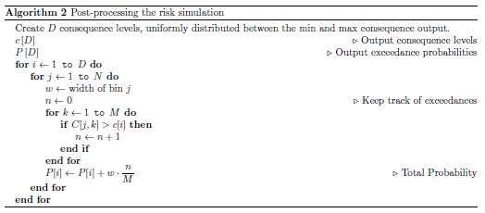
Advantages
Easy to implement with the existing modeling chain.
The sub-sampling framework can be used to derive all necessary output in a single loop:
AEP-Depth grids
AEP-Velocity grids
AEP-DV grids
AEP-Duration grids
AEP-Damage grids
Post-processing works the same for all outputs.

Slide 21
Limitations
Peak flow in HEC-HMS is used as the criteria to derive the importance sampling grid.
HEC-HMS does not account for backwater effects or nonlinearity in runoff.
This approach could neglect critical pluvial target locations.
This approach could result in some degradation in performance when propagated forward to RAS 2D.
This method will not work well in basins with low hydrologic correlation.
Ideally, the average inter-site hydrologic correlation should be ρ=0.5 or larger.
This will often be achievable for fluvial targets, but potentially more challenging for pluvial.
The choice in the number of m-bins and k-Neighbors seems somewhat arbitrary.

Slide 22
Next Steps
Test performance with HEC-RAS.
Test sensitivity of SST-HMS population size.
Test sensitivity of m-Bins and k-Neighbors for sub-sampling:
m x k: 10 x 10, 50 x 10, 25 x 20, 100 x 10, 50 x 20, 20 x 50
Test potential improvements to the routine:
Different importance criteria.
Normalization and standardization techniques.
Include joint probability from Gaussian copula as additional feature.
Assign weights to targets.
Test the other sub-sampling strategies and select the best method using on a cost-effectiveness measure.
Hybrid approach most likely preferrable.

Slide 23
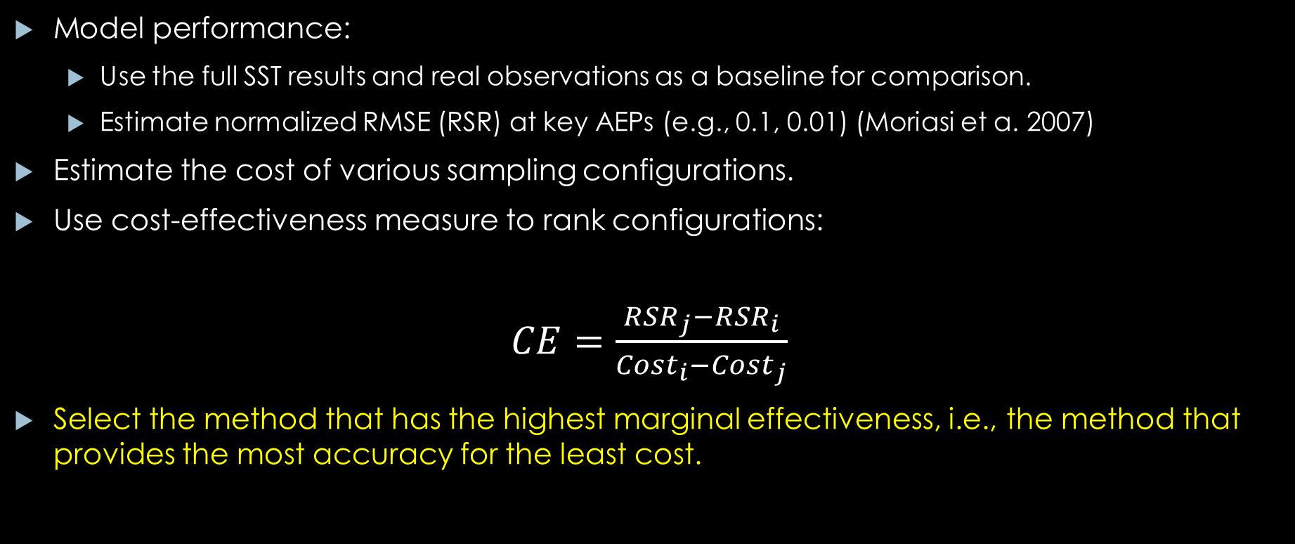
Cost-Effectiveness
Model performance:
Use the full SST results and real observations as a baseline for comparison.
Estimate normalized RMSE (RSR) at key AEPs (e.g., 0.1, 0.01) (Moriasi et a. 2007)
Estimate the cost of various sampling configurations.
Use cost-effectiveness measure to rank configurations:
$CE=$ $\frac{{RSR}_{j}−{RSR}_{i}}{{Cost}_{i}−{Cost}_{j}}$
Select the method that has the highest marginal effectiveness, i.e., the method that provides the most accuracy for the least cost.

